Slide 1

CSE- 207
Algorithm
Lecture: 04(part-2)
Fahad Ahmed
Lecturer, Dept. of CSE
E-mail: fahadahmed@uap-bd.edu

Slide 2


Recursion

Slide 3

C Recursion

Slide 4
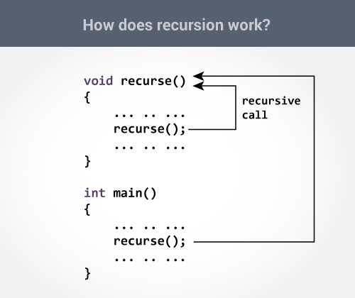
C Recursion
A function that calls itself is known as a recursive function. And, this technique is known as recursion.

Slide 5
Sum of Natural Numbers Using Recursion
1+2+3+…..+9+10 = 55 [sum of first n natural number]
int main()
{
int number, result;
printf("Enter a positive integer: ");
scanf("%d", &number);
result = sum(number);
printf("sum=%d", result);
}
#include <stdio.h>
int sum(int num)
{
if (num!=0)
return num + sum(num-1);
else
return num;
}

Slide 6
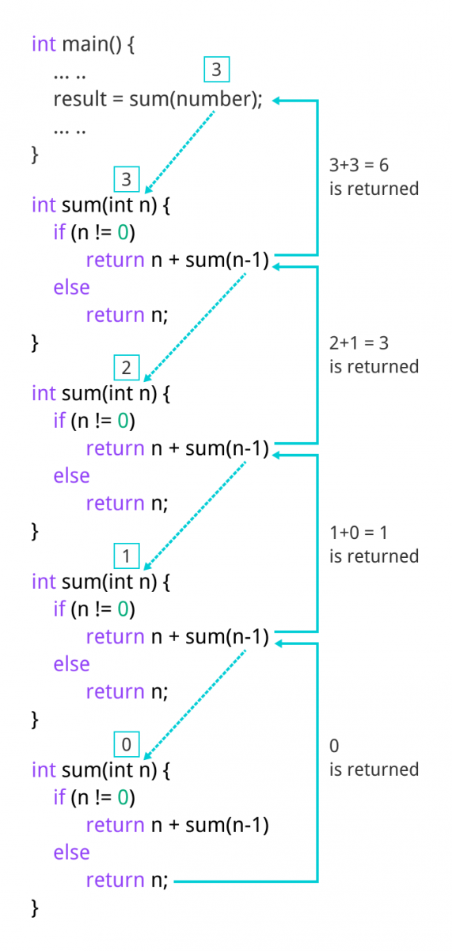
Sum of Natural Numbers Using Recursion

Slide 7
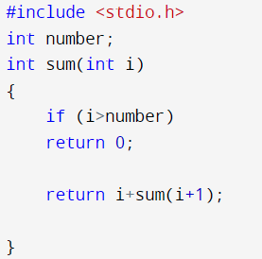
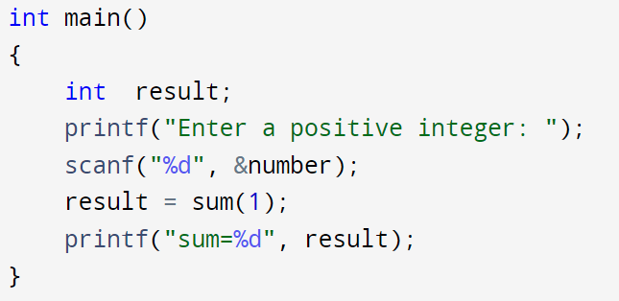
Sum of Natural Numbers Using Recursion
1+2+3+…..+9+10 = 55 [sum of first n natural number]

Slide 8
Sum of Natural Numbers Using Recursion
2+4+6+…..+n=?? [sum of first n even natural number]

Slide 9
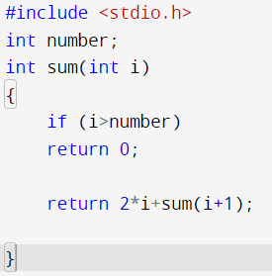
Sum of Natural Numbers Using Recursion
2+4+6+…..+n=?? [sum of first n even natural number]

Slide 10
Sum of Natural Numbers Using Recursion
1+3+5+…..+n=?? [sum of first n odd natural number]

Slide 11
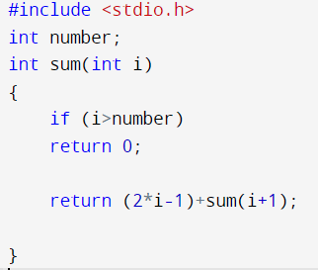
Sum of Natural Numbers Using Recursion
1+3+5+…..+n=?? [sum of first n odd natural number]

Slide 12
Factorial

Slide 13
factorial
#include <stdio.h>
int factorial(int n) {
if (n == 1)
return 1;
else
return (n * factorial(n-1));
}
int main(){
int n,result;
printf("Enter the value of n: ");
scanf("%d",&n);
result = factorial(n);
printf("Factorial is : %d",result);
return 0;
}
factorial(3) = 3 * factorial(2) 3 * 2 * factorial(1) 3 * 2 * 1 = 6

Slide 14
Digit sum
Given a number (Max-7),
find sum of its digits using recursion.
Input : 12345
Output : 15
Input : 456320
Output :20

Slide 15
Digit sum
#include <stdio.h>
int sum_of_digit(int n)
{
if (n == 0)
return 0;
return (n % 10 + sum_of_digit(n / 10));
}
int main()
{
int num;
scanf("%d",&num);
int result = sum_of_digit(num);
printf("Sum of digits in %d is %d\n", num, result);
return 0;
}

Slide 16
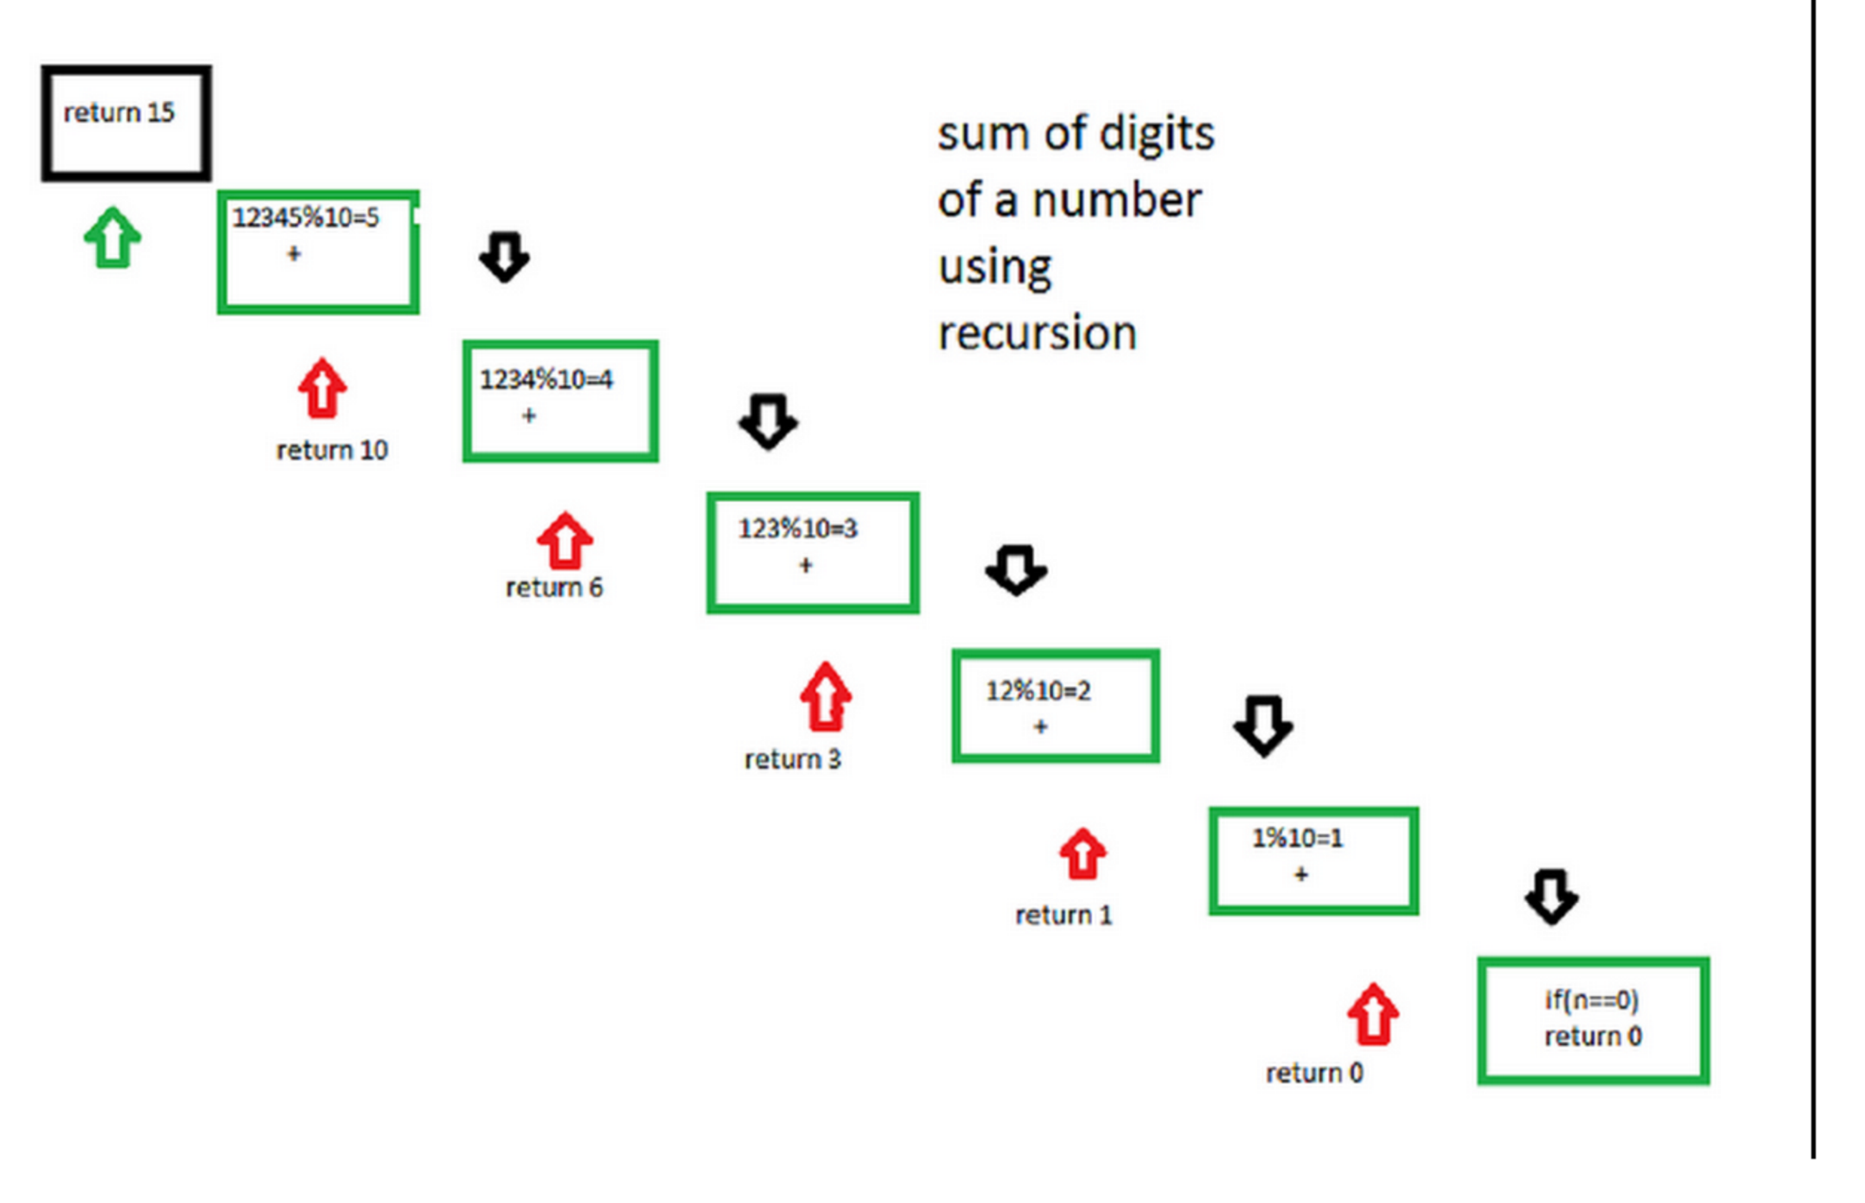
Digit sum

Slide 17
Digit sum
Let number be 12345. Step 1-> 12345 % 10 which is equal-too 5 + ( send 12345/10 to next step ) Step 2-> 1234 % 10 which is equal-too 4 + ( send 1234/10 to next step ) Step 3-> 123 % 10 which is equal-too 3 + ( send 123/10 to next step ) Step 4-> 12 % 10 which is equal-too 2 + ( send 12/10 to next step ) Step 5-> 1 % 10 which is equal-too 1 + ( send 1/10 to next step ) Step 6-> 0 algorithm stops

Slide 18
Single digit sum
#include <stdio.h>
int DigitSum(int num);
int main()
{
int n1, sum;
scanf("%d", &n1);
int s=n1;
while(s>9)
s = DigitSum(s);
printf("The Sum of digits of %d = %d\n\n", n1,s);
return 0;
}
int DigitSum(int n1)
{
if(n1 == 0)
return 0;
return ((n1 % 10) + DigitSum(n1 / 10));//calling the function DigitSum itself
}

Slide 19
Fibonacci
Program for Fibonacci numbers

Slide 20
Fibonacci
Program for Fibonacci numbers
Method 1:(Using formula) In this method we directly implement the formula for nth term in the Fibonacci series.
F_{n} = {[(√5 + 1)/2] ^ n} / √5

Slide 21
Fibonacci
Program for Fibonacci numbers
Method 1:(Using formula)
#include<stdio.h>
#include<math.h>
int fib(int n)
{
double phi = (1 + sqrt(5)) / 2;
return round(pow(phi, n) / sqrt(5));
}
int main ()
{
int n;
scanf("%d",&n);
printf("%d", fib(n));
return 0;
}

Slide 22
Fibonacci
Program for Fibonacci numbers
Method 2 ( Use recursion )
#include<stdio.h>
int fib(int n)
{
if (n <= 1)
return n;
return fib(n-1) + fib(n-2);
}
int main ()
{
int n;
scanf("%d",&n);
printf("%d", fib(n));
return 0;
}

Slide 23
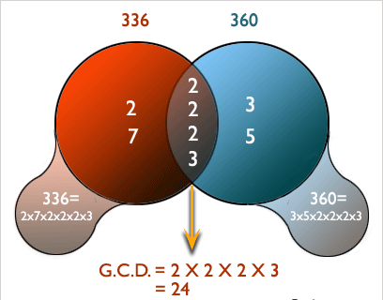
GCD

Slide 24
GCD
int findGCD(int a,int b)
{
while(a!=b)
{
if(a>b)
return findGCD(a-b,b);
else
return findGCD(a,b-a);
}
return a;
}
#include<stdio.h>
int findGCD(int num1,int num2);
int main()
{
int num1,num2,gcd;
printf(" Input 1st number: ");
scanf("%d",&num1);
printf(" Input 2nd number: ");
scanf("%d",&num2);
gcd = findGCD(num1,num2);
printf("\n The GCD of %d and %d is: %d\n\n",num1,num2,gcd);
return 0;
}

Slide 25
Recursion
What is tail recursion?
A recursive function is tail recursive when recursive call is the last thing executed by the function. For example the following C++ function print() is tail recursive.
void print(int n)
{
if (n < 0) return;
cout << " " << n;
// The last executed statement is recursive call
print(n-1);
}

Slide 26
Recursion
Why Overflow error occurs in recursion? If the base case is not reached or not defined, then the stack overflow problem may arise. Let us take an example to understand this.
If fact(10) is called, it will call fact(9), fact(8), fact(7) and so on but the number will never reach 100. So, the base case is not reached. If the memory is exhausted by these functions on the stack, it will cause a stack overflow error.
int fact(int n)
{
// wrong base case (it may cause overflow).
if (n == 100)
return 1;
else
return n*fact(n-1);
}

Slide 27
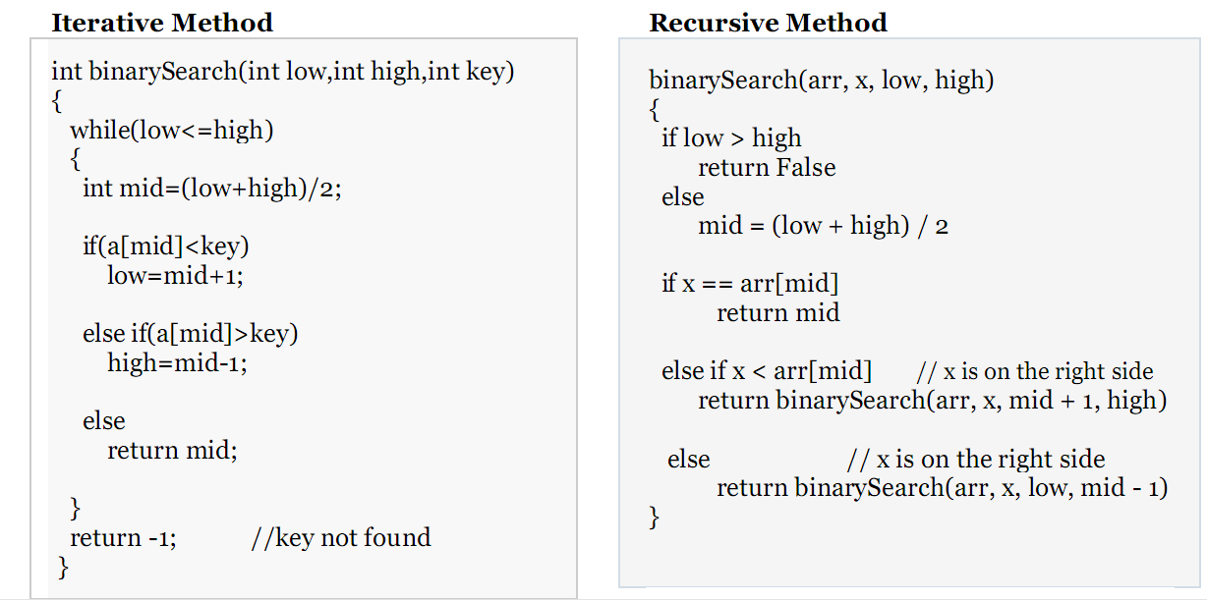
Recursion
Binary Search

Slide 28
Recursion
/* Recursive Linear Search */
#include<stdio.h>
int recSearch(int arr[], int l, int r, int x)
{
if (r < l)
return -1;
if (arr[l] == x)
return l;
if (arr[r] == x)
return r;
return recSearch(arr, l+1, r-1, x);
}
int main()
{
int arr[] = {12, 34, 54, 2, 3}, i;
int n = sizeof(arr)/sizeof(arr[0]);
int x = 3;
int index = recSearch(arr, 0, n-1, x);
if (index != -1)
printf("Element %d is present at index %d", x, index);
else
printf("Element %d is not present", x);
return 0;
}

Slide 29
রিকার্সিভ ফাংশন
https://hellohasan.com/2016/11/11/%e0%a6%b0%e0%a6%bf%e0%a6%95%e0%a6%be%e0%a6%b0%e0%a7%8d%e0%a6%b8%e0%a6%bf%e0%a6%ad-%e0%a6%ab%e0%a6%be%e0%a6%82%e0%a6%b6%e0%a6%a8-recursive-function-recursion/?relatedposts_hit=1&relatedposts_origin=2261&relatedposts_position=2
https://jakir.me/%E0%A6%B0%E0%A6%BF%E0%A6%95%E0%A6%BE%E0%A6%B0%E0%A6%B6%E0%A6%A8-recursion/
http://www.shafaetsplanet.com/?p=1022

Slide 30
Recursion
Recursion Practice Problems with Solutions
Easy Problems:
http://zobayer.blogspot.com/2009/12/cse-102-practice-recursions.html
Medium+ Hard Problems:
https://www.techiedelight.com/recursion-practice-problems-with-solutions/#:~:text=Recursion%20is%20a%20problem%2Dsolving,subproblem%20having%20a%20trivial%20solution.

Slide 31

Thanks to All

